Slide 1

Enabling Dynamic Network Access Control with Anomaly-based IDS and SDN
Hongda Li, Feng Wei, and Hongxin Hu
SDN-NFV Security 2019

Slide 2
Outline
Motivation
Background
Our Approach
Case Study

Slide 3





Network Access Control with SDN
FlowGuard [HotSDN’14]
Dynamic Firewall [RAID’15]
Access Control Policies
Virtual Firewall [NDSS’17]
How to generate new ACP?
Unknown vulnerabilities
Anomaly
Zero-day security threat

Slide 4
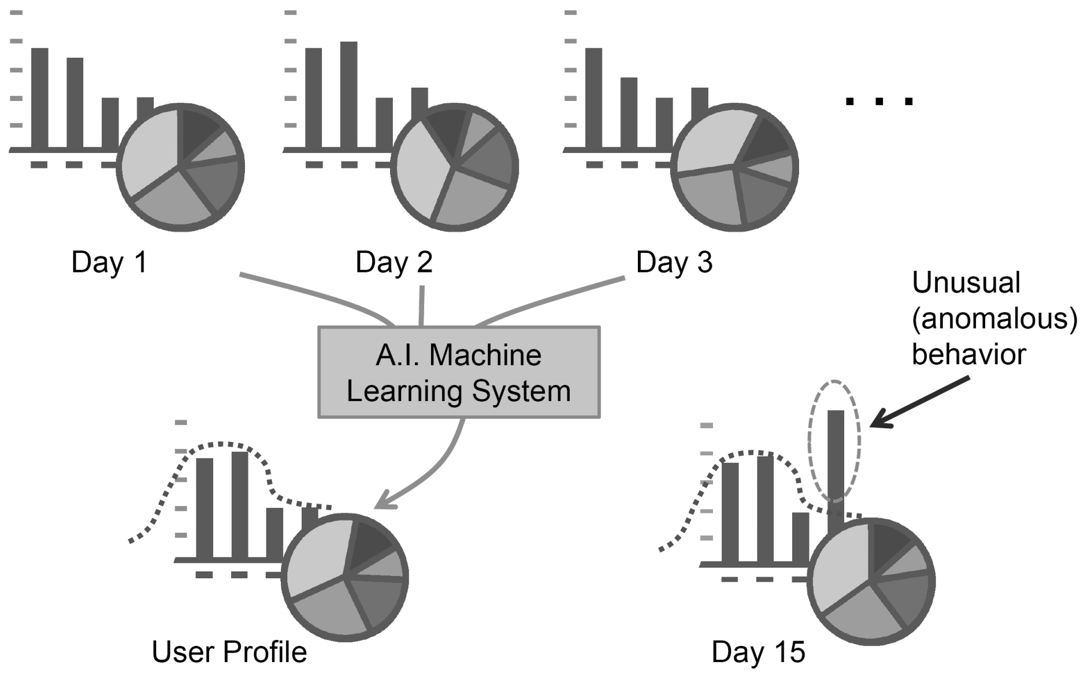
Existing Anomaly-based IDS
Semantic
Gap
Access Control Policies
Uncover novel security threats
Obscure outcome

Slide 5
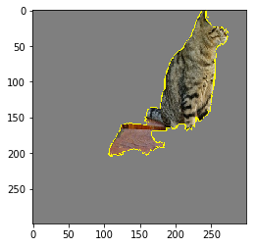
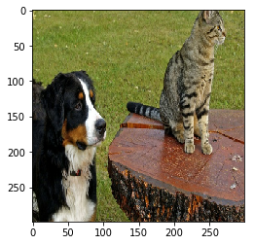

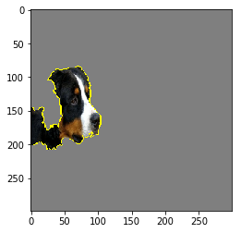
Machine Learning Model Explanation
CAT
Predictor
DOG
Input
Outcome
Explanation

Slide 6

Explanation Mechanisms
Black
Box
x
y
Whitebox
Blackbox
x₁
y₁
…
…
x_{i}
y_{i}
x_{n}
y_{n}
Global Explanation
Local Explanation

Slide 7



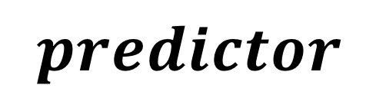


Local & Blackbox Explanation
Local Approximation
Explanation Logic
$$predictor$$
e$l$
$$l$$
e
$$x$$
Why $x$ is predicted as circle?

Slide 8

Approach Overview
SDN Controller
SDN Flow Rule
Access Control Policy
Mirrored Traffic
AIDS Outcome
Outcome Explanation
Anomaly-based
IDS
Outcome
Explanator
Policy
Generator
SDN Switch

Slide 9
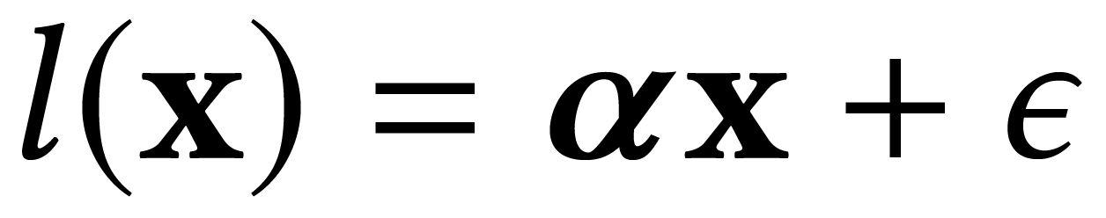
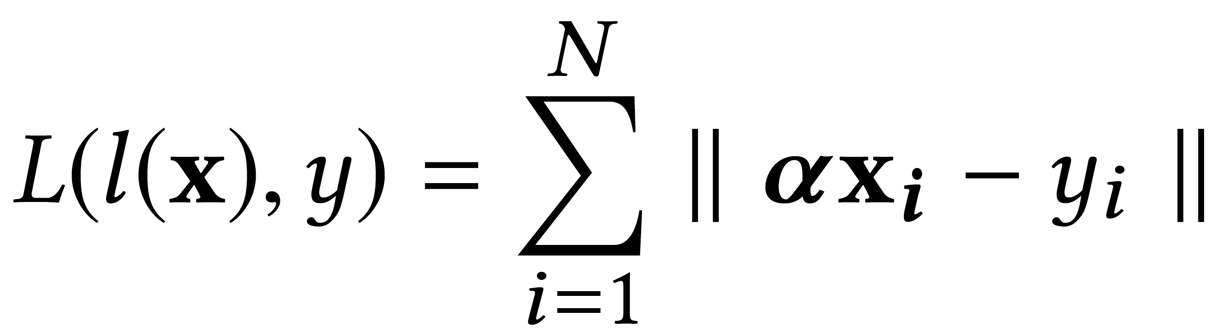
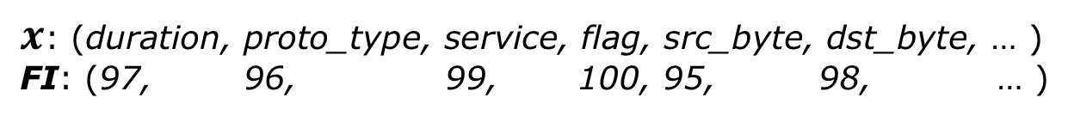
AIDS Outcome Explanation
Local Approximation
Explanation Logic
Linear Regression
F(x)
x
Feature Importance
$x$: (duration, proto_type, service, flag, src_byte, dst_byte, … )
FI: (97, 96, 99, 100, 95, 98, … )

Slide 10
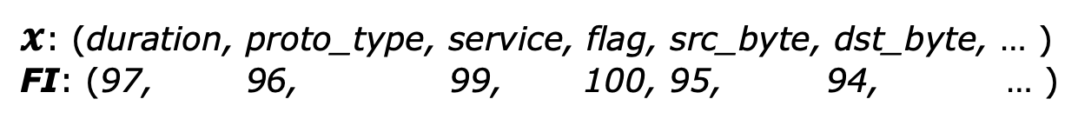
Access Control Policy Generation
<filers, actions>
Selects network entities
Defines action to take
Networks;
Hosts;
Connections;
Flows;
Packets;
Combination of above;
Allow;
Deny;
Redirect;
Quarantine;
Mirror;
…
$x$: (duration, proto_type, service, flag, src_byte, dst_byte, … )
FI: (97, 96, 99, 100, 95, 94, … )
Explanation

Slide 11
Case Study: AIDS
Recurrent Neural Network (RNN)
Detect across multiple records
NSL-KDD dataset
41 raw feature
Keras + TensorFlow for implementation

Slide 12
Case Study: Outcome Explanation
Choose Neptune attack in dataset
Extensive SYN error or SYN rejection
Two records labeled as Neptune attack
Explanation (Feature Importance)
Record1: (0, tcp, private, S0, …, 255, 20, 0.08, 0.07, 0, 0, 1, 1, 0, 0)
Record2: (0, tcp, imap4, REJ, …, 255, 17, 0.07, 0.07, 0, 0, 0, 0, 1, 1)
Percentage of SYN Error
Percentage of Rejection Error

Slide 13
Case Study: Policy Generation
Outcome Explanation
<filters=(ip_proto=tcp, tcp_flags=syn, sip=192.168.1.2, dip=192.168.1.3),
actions=(drop)>
Access Control Policy

Slide 14
Conclusion and Future Work
Conclusion
Explained the outcome of anomaly-based IDS
Generated network access control policy according to the explanation
Future work
Better explanation that handles decency among records
Policy generation process formalization
More evaluation on realistic traffic and attacks

Slide 15
Q & A
Hongda Li (hongdal@clemson.edu)
Thank you!

